Slide 1
Advanced Javascript
Asynchronous Programming

Slide 2
Program Execution

Slide 3
Synchronous Execution
One line at a time.
Javascript executes code line by line. Almost every programming language executes code line by line.

Slide 4

There will be some kind of code which will take long time to execute..

Slide 5
If all languages are synchronous, isn’t that a bad thing?

Slide 6
There is a way….

Slide 7
Asynchronous Execution
Multiple resource. Multiple execution at a time.

Slide 8

But Js is Single threaded, it cannot do multiple things at same time.

Slide 9

Js can act asynchronous with the help of a friend.

Slide 10
Enter Browser API

Slide 11
Whenever Js Engine encounters a piece of code that will take a long time to execute, it hands over it’s execution to browser.

Slide 12
Browser now takes care of that task and when its finished, it pings the Js engine that the task is done.

Slide 13
That’s how Js engine and Browser work together to make Javascript capable of asynchronous programming.

Slide 14
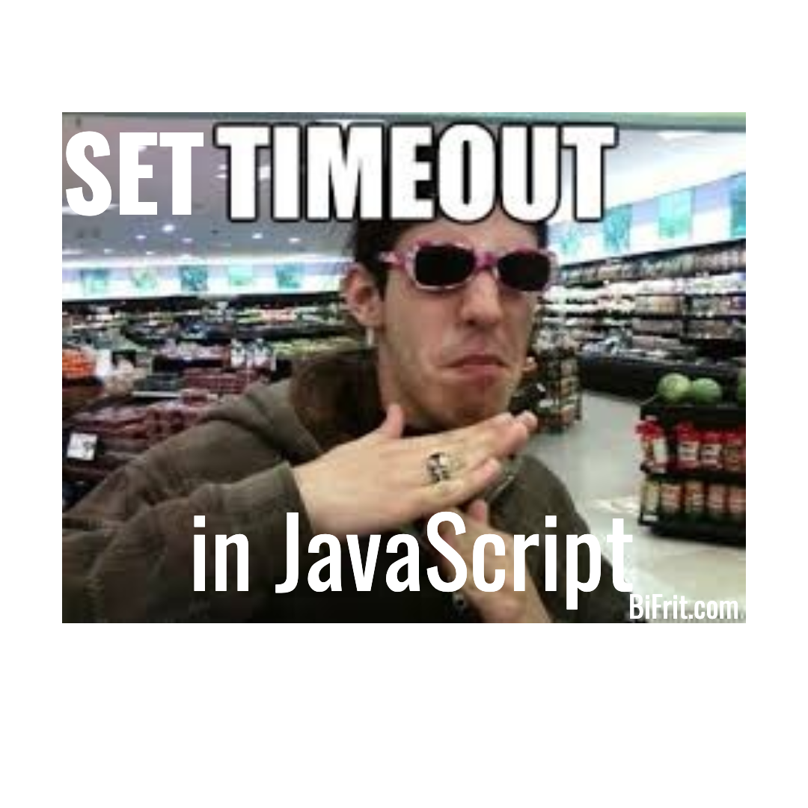
setTimeout

Slide 15
What is setTimeout()?
setTimeout sets a timer which executes a function or specified piece of code once the timer expires.

Slide 16
Whenever setTimeout() is encountered in a Js code, Js engine offloads that code to browser.
Now, it’s browser’s responsibility to keep track of counter and remind Js engine that this code should be executed next.

Slide 17
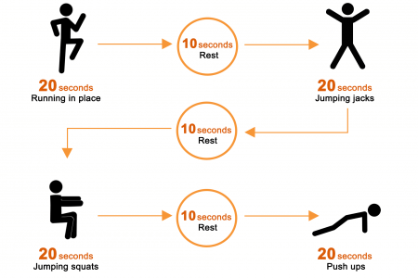
setInterval()

Slide 18
What is setInterval()?
setInterval() method repeatedly calls a function or executes a code snippet, with a fixed time delay between each call.

Slide 19
But how does Js engine keeps track of what to execute next?

Slide 20
Enter Stack and Queue

Slide 21
Let’s revisit stack and see where the new concept called ‘queue’ fits in.

Slide 22
Stack
When you call a function in JavaScript all the instructions within that function get loaded into a Stack.
Javascript then executes the instructions in each function by popping them from the stack.

Slide 23
function main()
{
average()
}
function average()
{
add()
}
function add()
{
}
main()

Slide 24
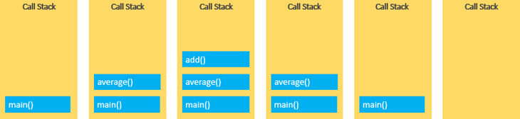

Slide 25
Message Queue/Callback Queue
It’s a one more data structure that Js to add next code to execute.
Such code are called tasks, since they need more time to execute.
Tasks are added to the queue whenever Js finds a function which will take some time to execute.

Slide 26
Whenever Js finds Functions like setTimeout and setInterval which requires a particular time to execute, it also add them to the message queue.

Slide 27
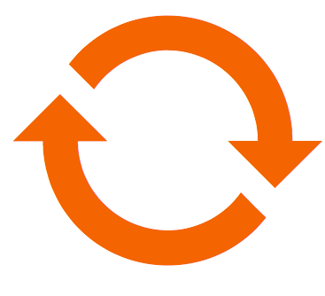
Event Loop

Slide 28
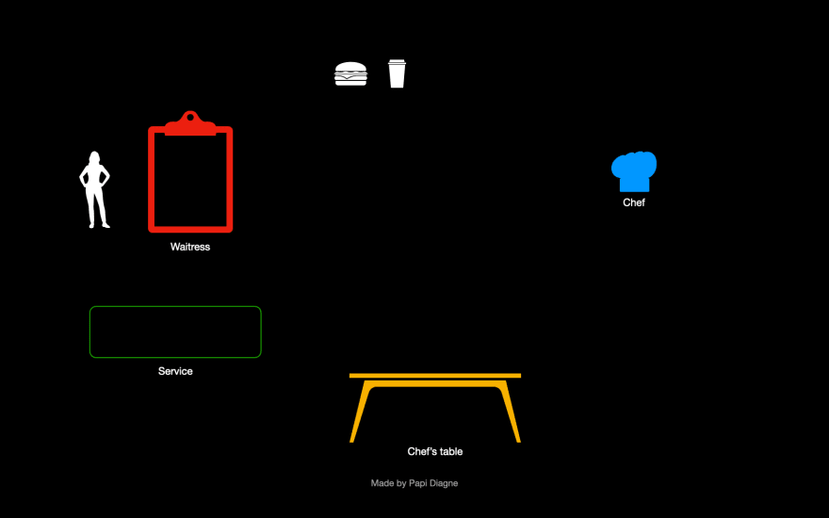

Slide 29


Slide 30
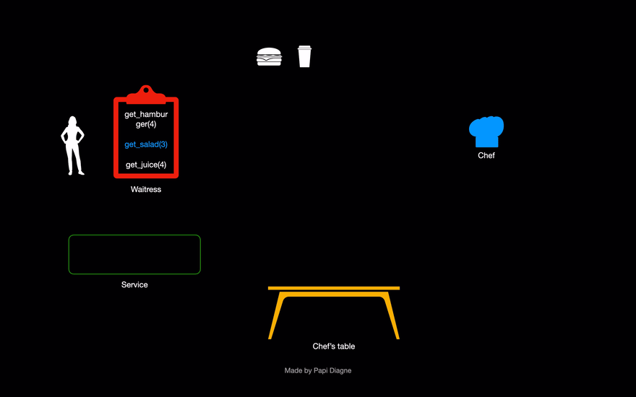

Slide 31
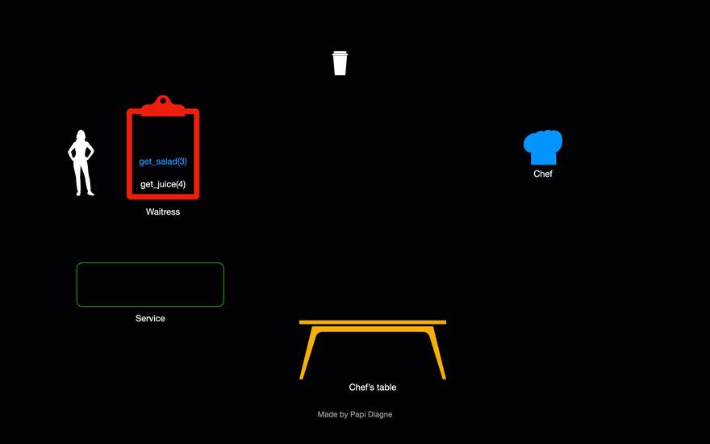

Slide 32
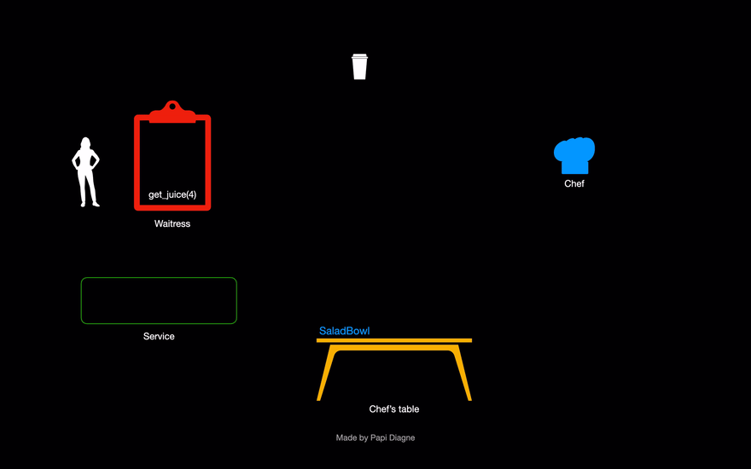

Slide 33
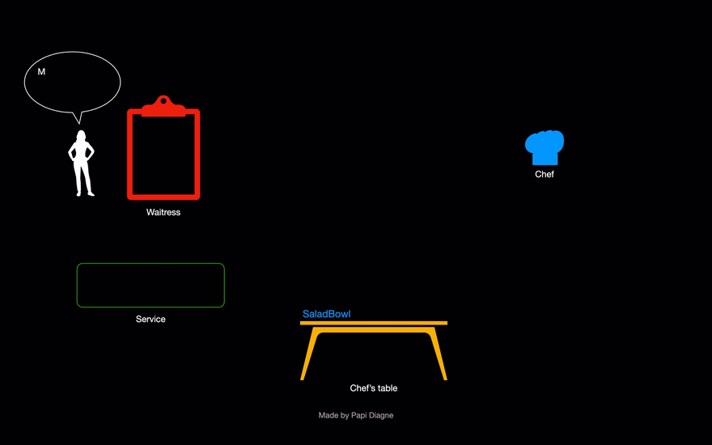

Slide 34
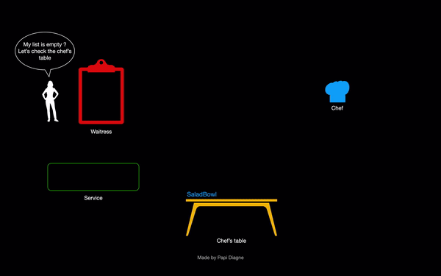

Slide 35


Slide 37
Let’s add our fancy words now and make sense of this model.

Slide 38
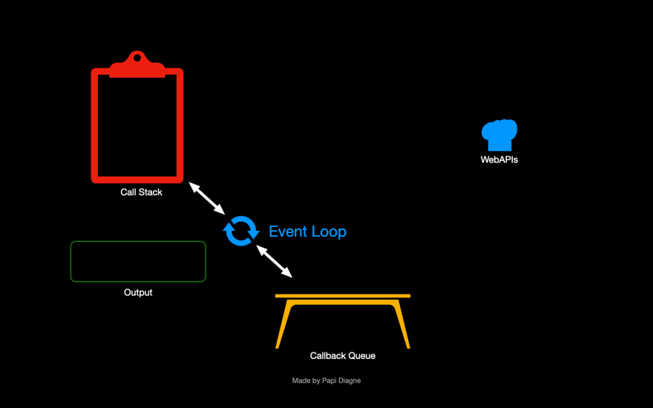

Slide 39
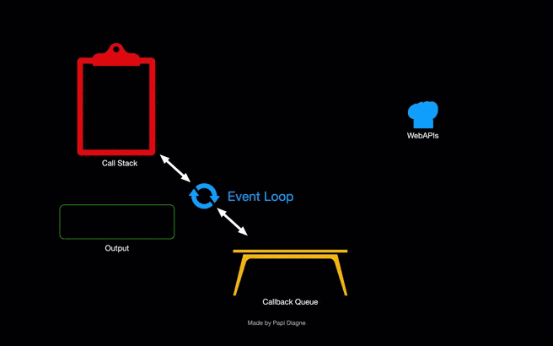

Slide 40
https://dev.to/lydiahallie/javascript-visualized-event-loop-3dif
http://latentflip.com/loupe/

Slide 41
JavaScript runs a loop that looks for new messages/tasks on the message queue and pushes them onto the call stack to be executed.

Slide 42
However, the event loop gives priority to the code currently on the call stack .
It pushes a new message from the Queue onto the stack after all the code in the stack have been executed and the call stack is empty.

Slide 43
Queue holds all the code that will require a longer time to execute. Especially, network requests.

Slide 44
But why asynchronous programing is important?

Slide 45
Most programs you write often tend to be synchronous. This means that actions in code happen one at a time.

Slide 46
For example HTTP requests could take any amount of time to receive a response from the server. There is even a chance you won't even get a response!
This is known as blocking and can slow down app performance.

Slide 47
Let’s Recap

Slide 48

Synchronous Execution -

Slide 49
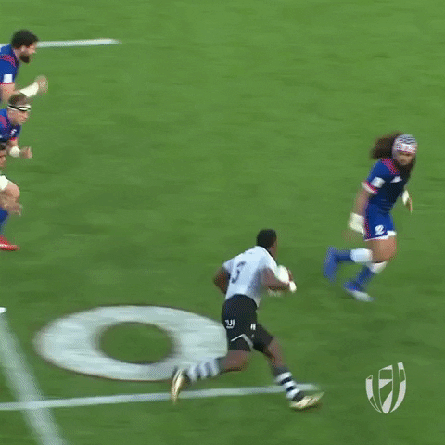
Asynchronous Execution

Slide 50

setTimeout

Slide 51

setInterval

Slide 52

Message/Task Queue

Slide 53
Event Loop

